Slide 1
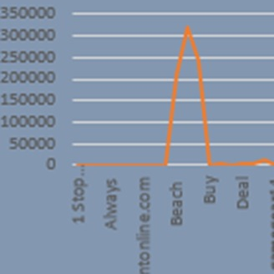
Electronics Products
Portfolio
BAHAR RUSTAMOVA

Slide 2
Editing of Data
When I first looked at the data, I noticed that the data was confusing and messy.
I expanded the columns to make the data clearer.
I have shown the data in all columns on the left side.

Slide 3
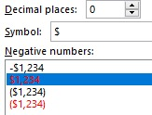
Product Currency and Price column
Since there is both Price and Price currency column, I filtered in Price Currency table, and because USD of all currency is CAD in only 1 row, I replaced the CAD currency with USD according to the date of the data cleaning day, I have put a "$" sign next to the value in Price column.
I also rounded the values in the Price column.

Slide 4


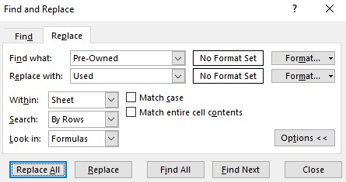
Product Condition Column
Capitalize all words and I applied this code to all rows
All data beginning with “new” has been replaced with “New”
Those containing the word “refurbished” were replaced with “Refurbished “
Those containing the word “pre-owned”
were replaced with “Used “
Deleted unnecessary data

Slide 5
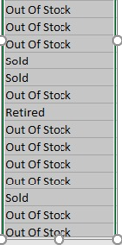

Product Availability Column
“32 available”, “7 available”, “More on the way”, “True”, “Yes”, “In stock”--since these words mean the same according to the data, we replace them all with the word “In stock".
“No”, “Retired”, “Sold”, “False”, “Out of stock” --since these words mean the same according to the data, we replace them all with the word “Out of stock".

Slide 6
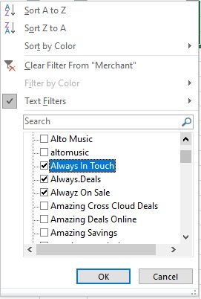
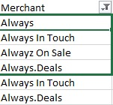
Merchant Column
I replace similar data with same name

Slide 7

Shipping Column
Similar headings related to the Shipping column have been replaced by 1. For example, “FREE”,”Free Delivery”,”Free Shipping” and exc, replaced with “Free”.
Valued shippings have been replaced with “Shipping charges apply”.
Since there are empty cells in the data, I fill them and write "unknown".

Slide 8
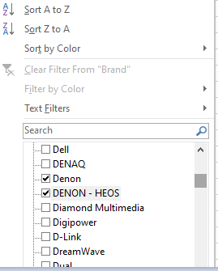

Brand Column
Similar headings related to the Shipping column have been replaced by 1. For example, “Denon”,”DENON-HEOS” and exc, replaced with “Denon”.

Slide 9
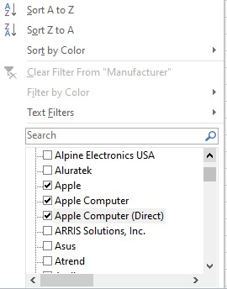
Manufacturer Column
Similar headings related to the Shipping column have been replaced by 1. For example, “Apple”, ”Apple Computer”, ”Apple Computer(Direct)” and exc, replaced with “Apple”.
Since there are empty cells in the data, I fill them and write "unknown".

Slide 10
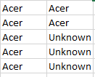
If we match the Brand and Manufacturer columns, we can see that the Manufacturers belonging to some Brands are unknown. That is, there was a gap from the beginning, and then we filled it as unknown. But if the Manufacturer corresponding to the Brand is the same in many rows, we can match it with others in the Unknown Manufacturer for the same Brand.
Brand Manufacturer

Slide 11
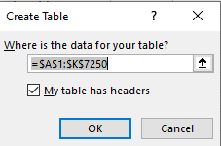



Remove Duplicates
And create table from your data

Slide 12

Analysis of table

Slide 13
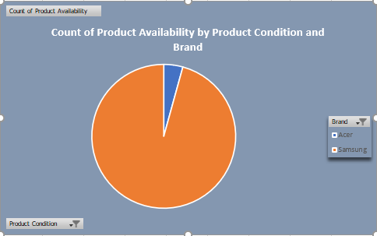
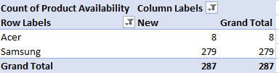
Pivot table1
Pivot tabel1 is set as row-Brand, column-Product Condition, value-Count of Product Availability. We have 2 slicers, one of them is Is Sale column, another is Shipping column. I have used Pie chart for it. Thus, we can analyze according to the number of Product Availability according to the Product Condition belonging to any Brand. For example, we can understand the analysis more easily in pictures.

Slide 14
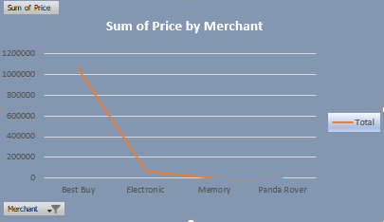
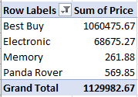
Pivot table2
Pivot tabel1 is set as row-Merchant, value-Sum of Price. We have 1 slicer,it is Primary Categories. I have used Line chart for it. For any Merchant, we have analyzed the Price total for the products. For example, we can understand the analysis more easily in pictures.

Slide 15

The last part of the analysis

Slide 16
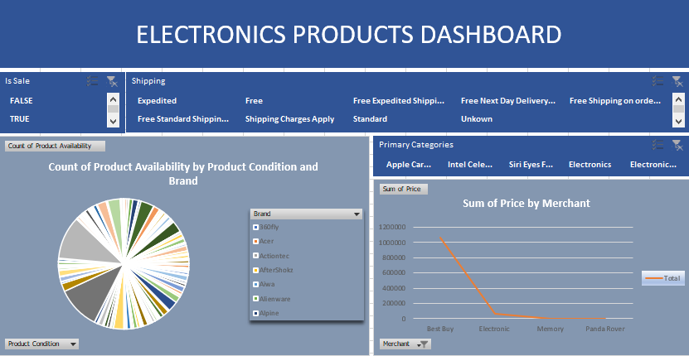

Slide 17

Thanks for Your Attention
If you have any question,
please contact with me
baharrustemova08@gmail.com

